Slide 1
MATHEMATICAL INDUCTION Lecture # 17

Slide 2
INTRODUCTION
Suppose we have an infinite ladder, and we want to know whether we can reach every step on this ladder. We know two things:
We can reach first rung of the ladder.
If we can reach a particular rung of the ladder, then we can reach the next rung.

Slide 3
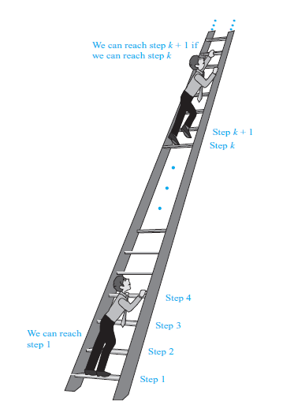

Slide 4
Many theorems state that P(n) is true for all positive integers ‘n’. Where P(n) is a propositional function.
Example:
1 + 2 + 3 + ….. + n = n(n + 1)/2
or
n ≤ 2^{n}

Slide 5
Mathematical induction is a technique for proving theorems of this kind.
In other words, Mathematical Induction is used to prove propositions of the form ∀nP(n).
When
Universe of discourse is the set of positive integers.

Slide 6
PRINCIPLE OF MATHEMATICAL INDUCTION
Let P(n) be a propositional function defined for all positive integers n. P(n) is true for every positive integer n if:
Basis Step:
The proposition P(1) is true.
Inductive Step:
If P(k) is true then P(k + 1) is true for all integers k ≥ 1.
i.e. ∀k P(k) → P(k + 1)

Slide 7
EXAMPLE
Use Mathematical Induction to prove that
for all integers n ≥1
SOLUTION
Let
Basis Step:
P(1) is true.
For n = 1, left hand side of P(1) is the sum of all the successive integers starting at 1 and ending at 1, so LHS = 1 and RHS is

Slide 8
and RHS is
so the proposition is true for n = 1.
Inductive Step: Suppose P(k) is true for, some integers k ≥ 1.
(1)
To prove P(k + 1) is true. That is,
(2)

Slide 9
Consider L.H.S. of (2)
Hence by principle of Mathematical Induction the given result true for all integers greater or equal to 1.

Slide 10
EXERCISE
Use mathematical induction to prove that
1+3+5+…+(2n -1) = n² for all integers n ≥1.
SOLUTION:
Let P(n) be the equation 1+3+5+…+(2n -1) = n²
Basis Step:
P(1) is true
For n = 1, L.H.S of P(1) = 1and
R.H.S = 1² = 1
Hence the equation is true for n = 1

Slide 11
Inductive Step:
Suppose P(k) is true for some integer k ≥ 1. That is,
1 + 3 + 5 + … + (2k - 1) = k² …………………(1)
To prove P(k+1) is true; i.e.,
1 + 3 + 5 + … +[2(k+1)-1] = (k+1) ² …….…(2)

Slide 12
Consider L.H.S. of (2)
Thus P(k+1) is also true. Hence by mathematical induction, the given equation is true for all integers n≥1.

Slide 13
EXERCISE
Use mathematical induction to prove that
1+2+2² + … + 2^{n} = 2^{n+1} - 1 for all integers n ≥0
SOLUTION:
Let
P(n): 1 + 2 + 2² + … + 2^{n} = 2^{n+1} – 1
Basis Step:
P(0) is true.
For n = 0
L.H.S of P(0) = 1
R.H.S of P(0) = 2⁰⁺¹ - 1 = 2 - 1 = 1
Hence P(0) is true.

Slide 14
Inductive Step:
Suppose P(k) is true for some integer k ≥ 0; i.e.,
1+2+2²+…+2^{k} = 2^{k+1} – 1……………………(1)
To prove P(k+1) is true, i.e.,
1+2+2²+…+2^{k+1} = 2^{k+1+1} – 1……………..…(2)

Slide 15
Consider LHS of equation (2)
1+2+2²+…+2^{k+1}= (1+2+2²+…+2^{k}) + 2^{k+1}
= (2^{k+1} – 1) +2^{k+1}
= 2·2^{k+1} – 1
= 2^{k+1+1} – 1
= R.H.S of (2)
Hence P(k+1) is true and consequently by mathematical induction the given propositional function is true for all integers n≥0.

Slide 16
EXERCISE
Prove by mathematical induction
PROOF: for all integers n ≥1.
Let P(n) denotes the given equation
Basis step:
P(1) is true
For n = 1
L.H.S of P(1) = 1² = 1
R.H.S of P(1)
So L.H.S = R.H.S of P(1).Hence P(1) is true

Slide 17
Inductive Step:
Suppose P(k) is true for some integer k ≥1;
………(1)
To prove P(k+1) is true; i.e.;
………(2)
Consider LHS of above equation (2)

Slide 20
EXERCISE
Prove by mathematical induction
for all integers n≥1
PROOF:
Let P(n) be the given equation.
Basis Step:
P(1) is true
For n = 1
L.H.S of P(1) =
R.H.S of P(1) =
Hence P(1) is true

Slide 21
Inductive Step:
Suppose P(k) is true, for some integer k≥1.
That is
To prove P(k+1) is true. That is
Now we will consider the L.H.S of the equation (2) and will try to get the R.H.S by using equation ( 1) and some simple computation.

Slide 22
Consider LHS of (2)

Slide 23
Hence P(k+1) is also true and so by Mathematical induction the given equation is true for all integers n ≥1.

Slide 24
EXERCISE
Use mathematical induction to prove that
PROOF:
Basis Step:
To prove the formula for n = 0,
we need to show that
Now, L.H.S =

Slide 25
R.H.S = 0·2² + 2 = 0 + 2 = 2
Hence the formula is true for n = 0
Inductive Step:
Suppose for some integer n=k ≥0
………(1)
We must show that

Slide 26
Consider LHS of (2)
Hence the inductive step is proved as well. Accordingly by mathematical induction the given formula is true for all integers n≥0.

Slide 27
EXERCISE
Use mathematical induction to prove that
for all integers n ≥2
PROOF:
Basis Step:
For n = 2
L.H.S
R.H.S
Hence the given formula is true for n = 2

Slide 28
Inductive Step:
Suppose for some integer k ≥2
………….(1)
We must show that
…..(2)
Consider L.H.S of (2)

Slide 29
Hence by mathematical induction the given equation is true

Slide 30
EXERCISE
Prove by mathematical induction
for all integers n≥1
PROOF:
Basis step:
For n = 1
L.H.S
R.H.S = (1+1)! - 1 = 2! - 1
= 2 -1 = 1
Hence
which proves the basis step.

Slide 31
Inductive Step:
Suppose for any integer k ≥1
………..(1)
We need to prove that
..………(2)
Consider LHS of (2)

Slide 32
Hence the inductive step is also true.
Accordingly, by mathematical induction, the given formula is true for all integers n ≥1.

Slide 33
Examples of Proving Divisibility Statements by Mathematical Induction

Slide 34
Divisibility in Mathematical Induction

Slide 35
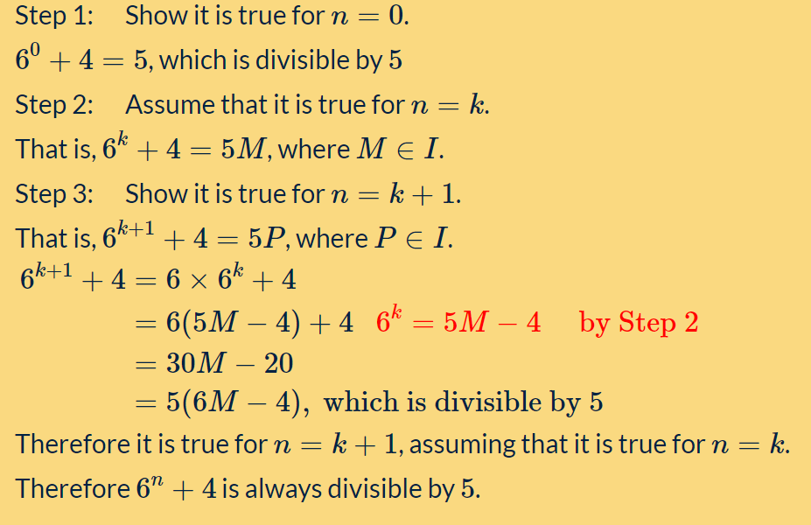

Slide 36
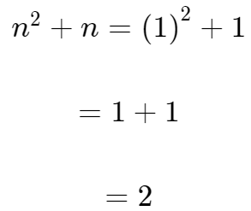
Example 2: Use mathematical induction to prove that n²+n is divisible by 2 for all positive integers n.
Basis step: show true for n=1.
Yes, 2 is divisible by 2.

Slide 37
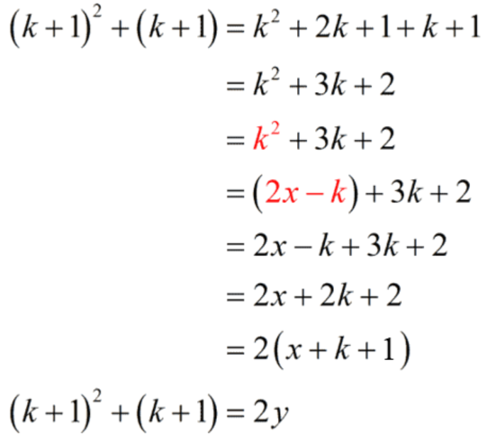
Inductive Step:
Assume that the statement is true for n=k. Thus, n²+n becomes k²+k where k is a positive integer.
(1)------------- k²+k=2x for some integer x.
Solve for k². We will use this for substitution later.
(1)--------------k²=2x−k
Prove the statement is true for n=k+1.
(2)----------- (k+1)² +(k+1) = 2y for some integer y.
Now will take L.H.S of equation 2:
Where y=x+k+1
This means that (k+1)²+(k+1) is also divisible by 2.

Slide 38
Example 3: Use mathematical induction to prove that 9^{n}+3 is divisible by 4 for all positive integers n.
Example 4: Use mathematical induction to prove that 8^{n}−3^{n} is divisible by 5 for all positive integers n.
Example 5: Use mathematical induction to prove that 5^{2n−1}+1 is divisible by 6 for all positive integers n.

